Slide 1

Hands On of Verification Techniques
Composed by: Yunus S. Suwarinoto, Nanda A., Ida P.
Meteorological, Climatological, and Geophysical Agency of Indonesia

Slide 2
Choose The Date
1
2
Click the date text below
Click the date text below
31 May 2021
1 June 2021
3
Click the date text below
2 June 2021

Slide 3
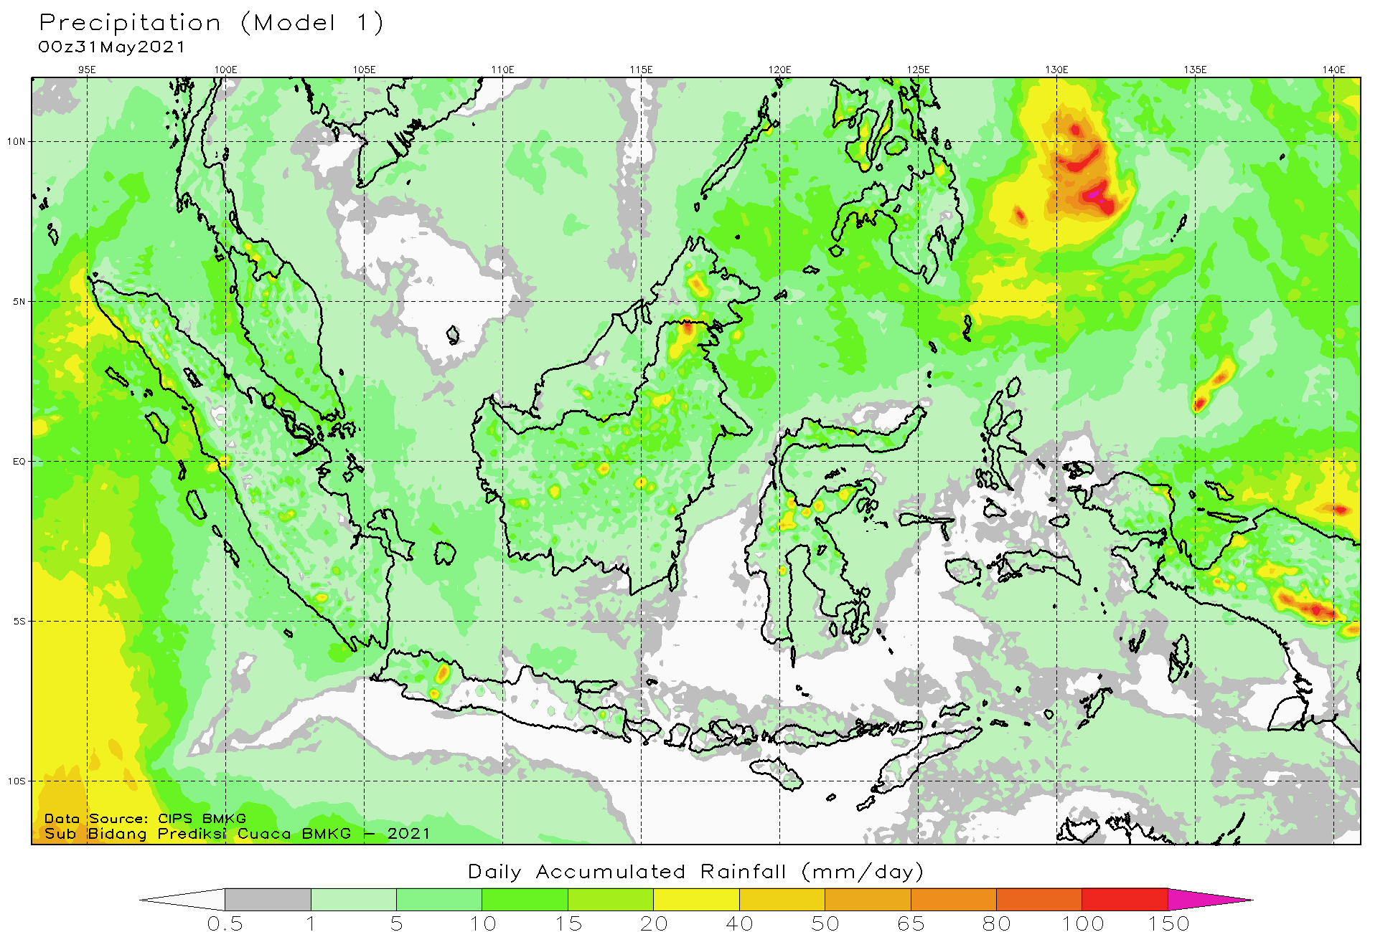
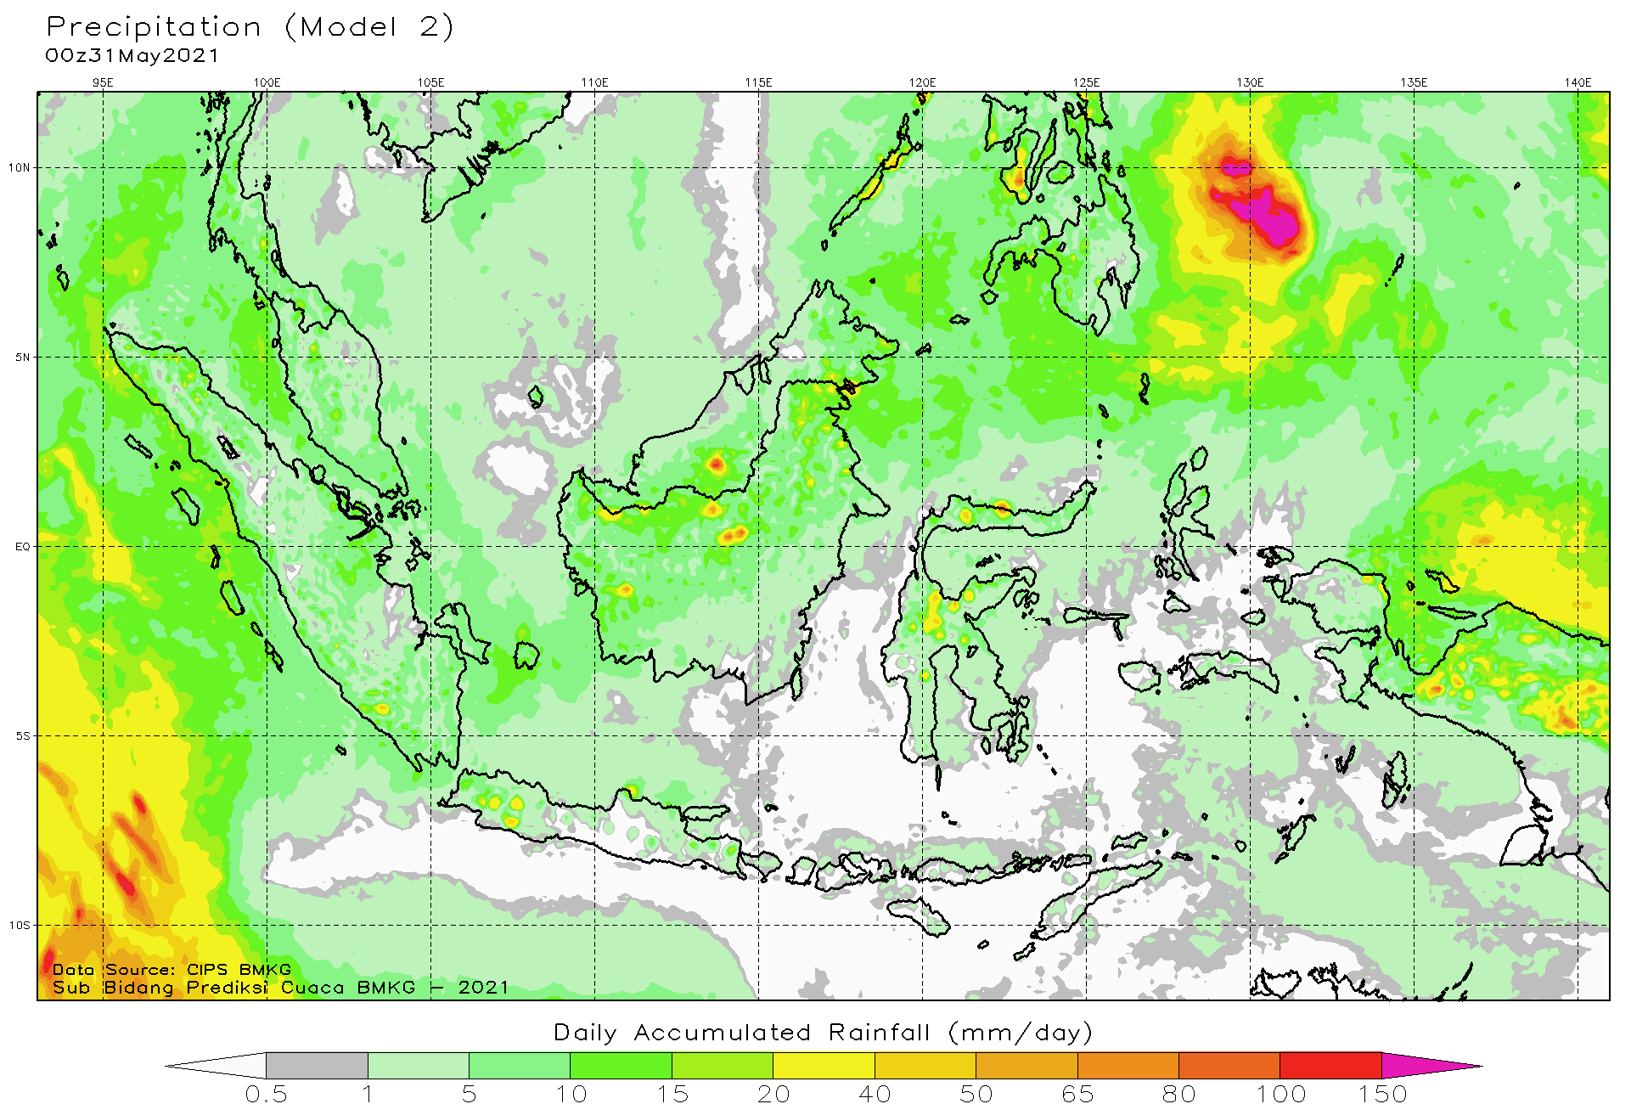
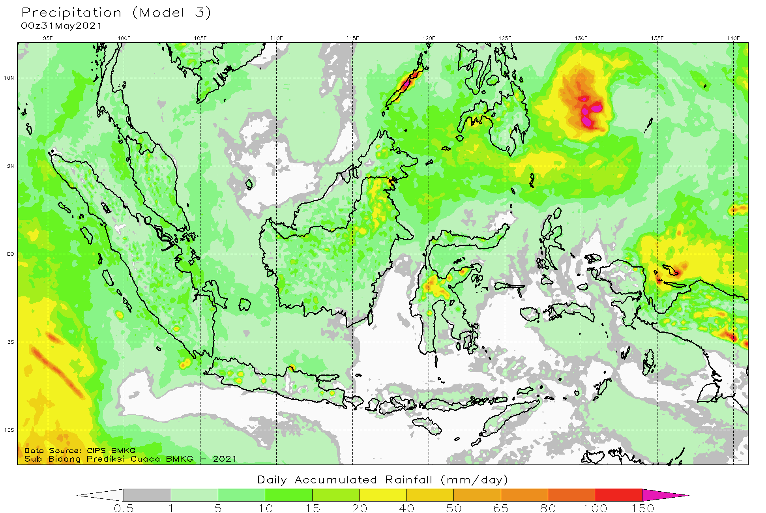
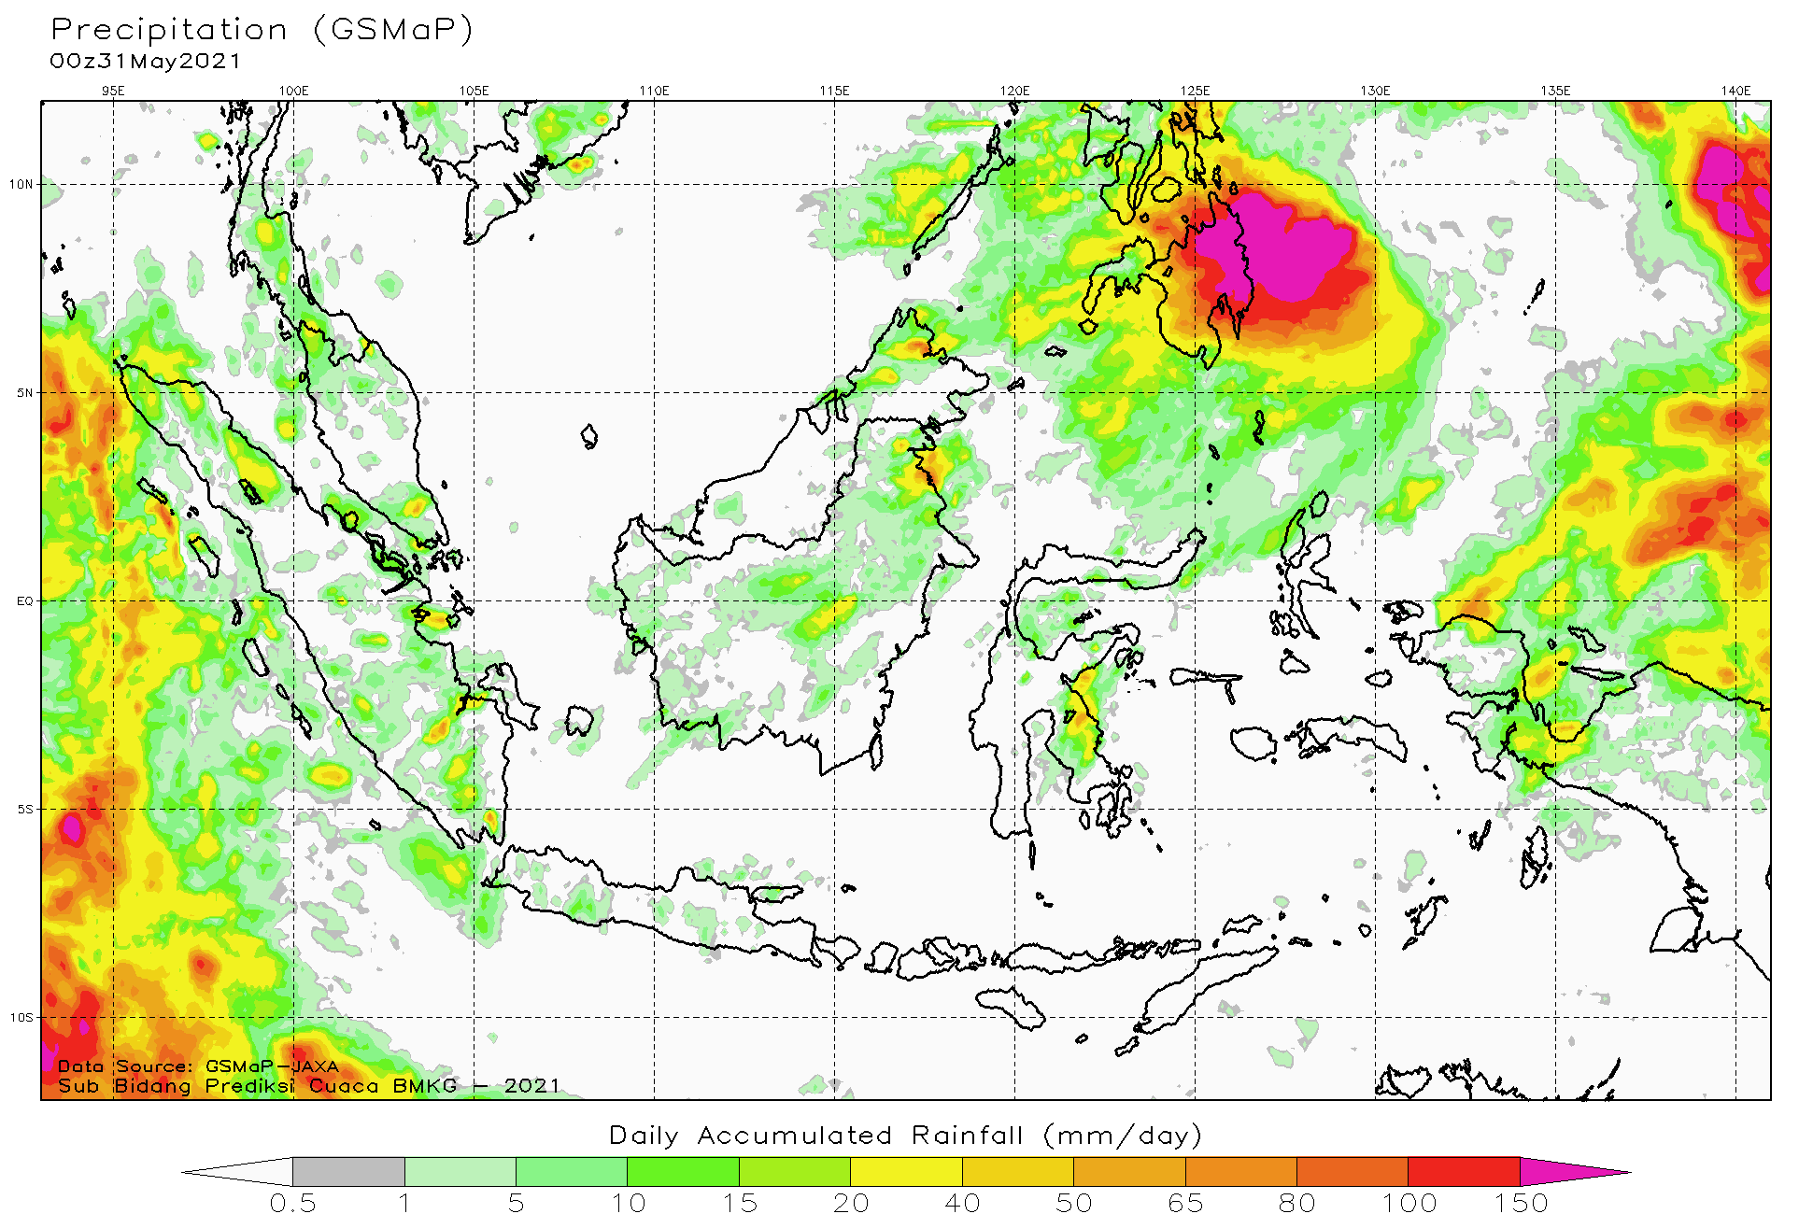
31 May 2021
Analysis
Model 1
Model 2
Make analisis referring to 3 keys of eyeball verification for spatial map:
1) Intensity
2) Location
3) Area Coverage
Model 3
GSMaP

Slide 4
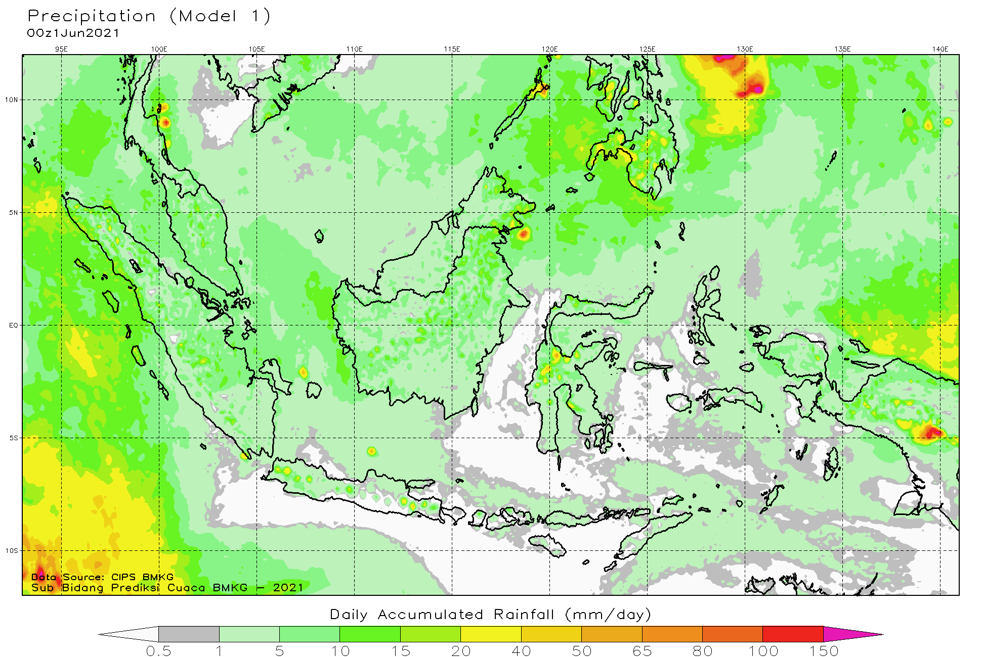
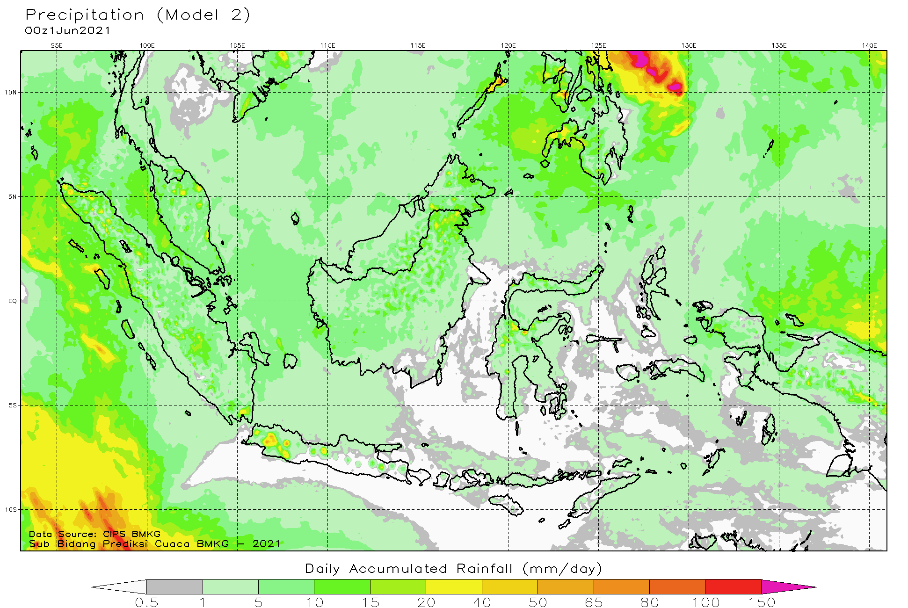
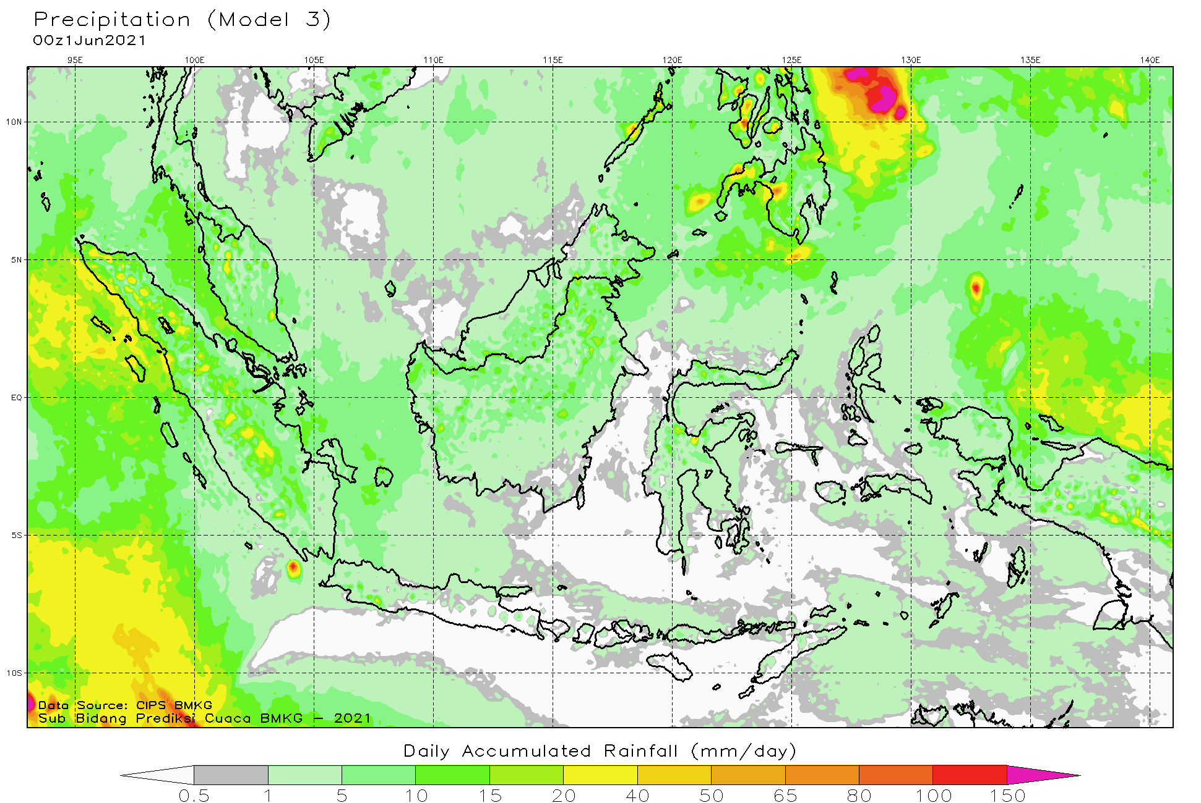
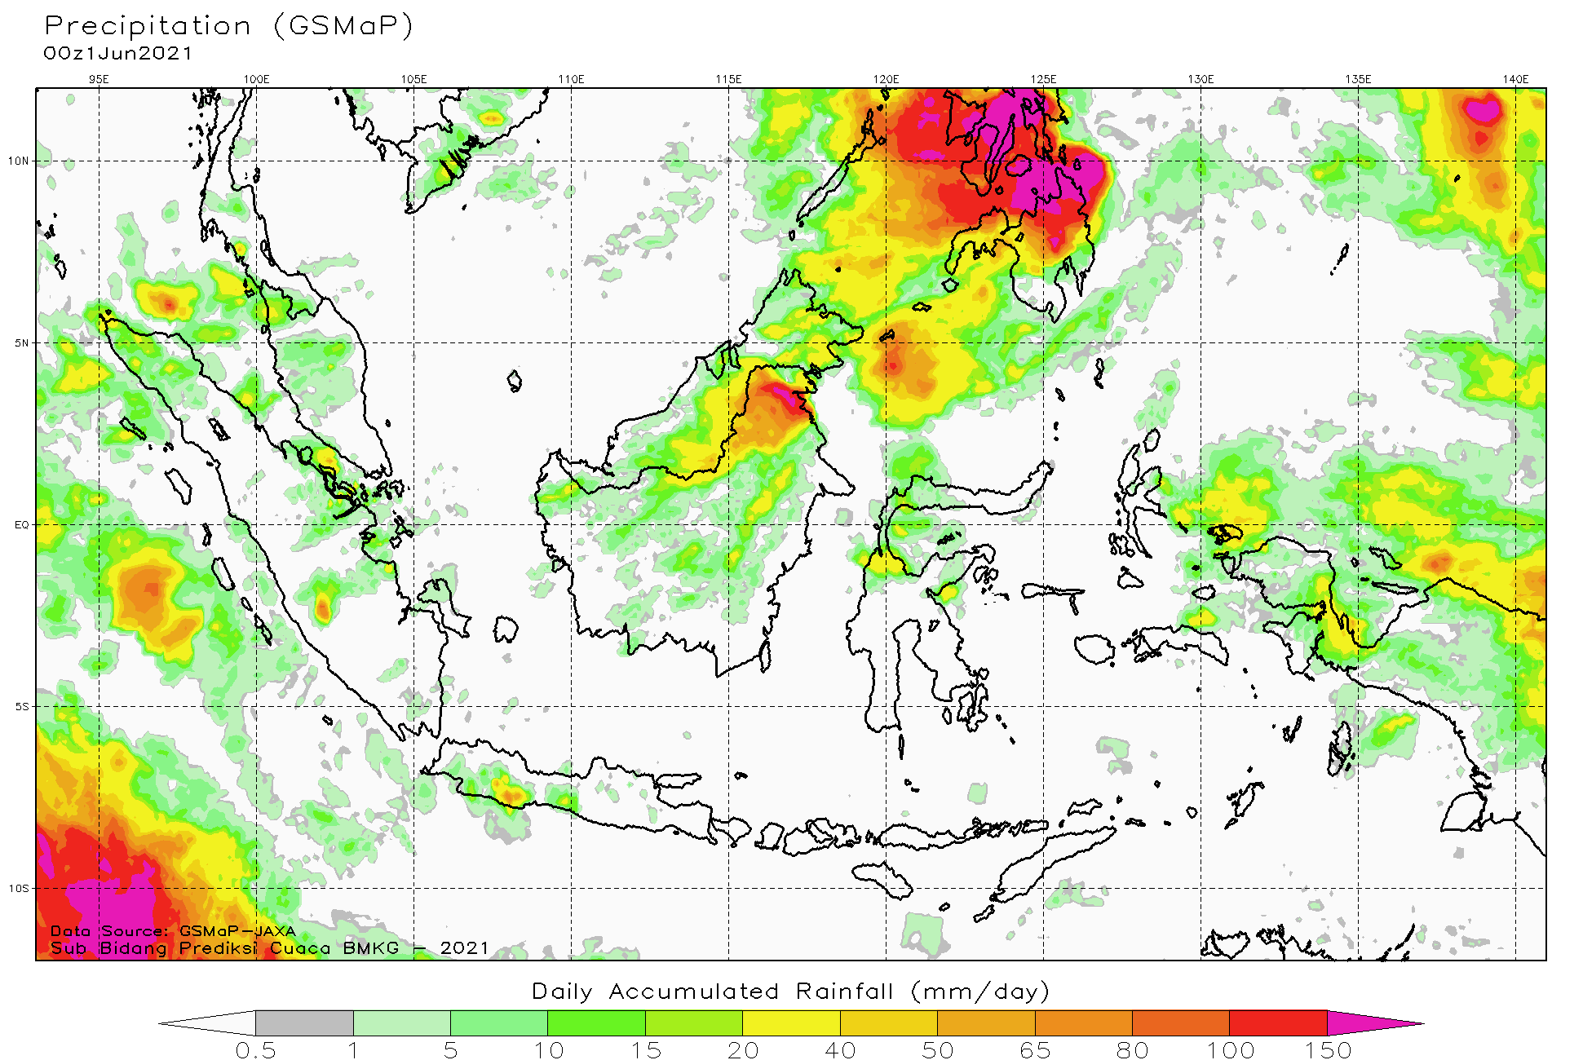
1 June 2021
Analysis
Model 1
Model 2
Make analisis referring to 3 keys of eyeball verification for spatial map:
1) Intensity
2) Location
3) Area Coverage
Model 3
GSMaP

Slide 5
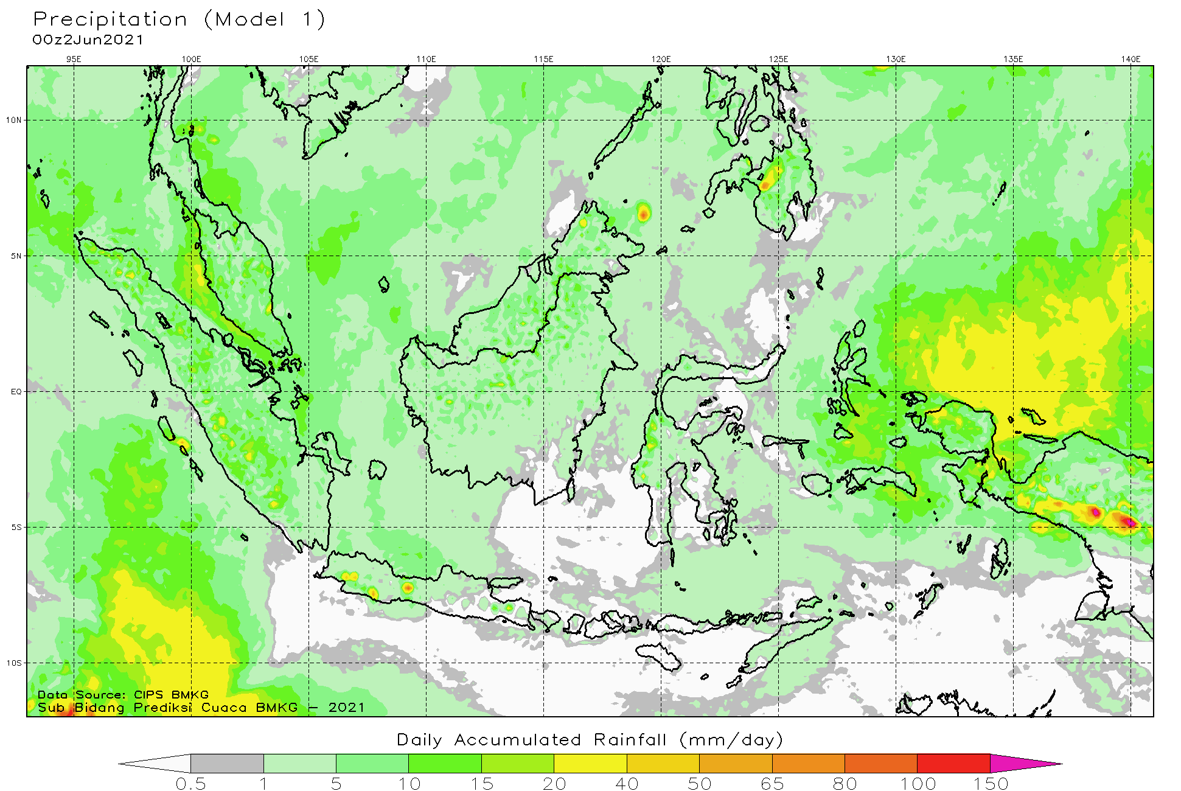
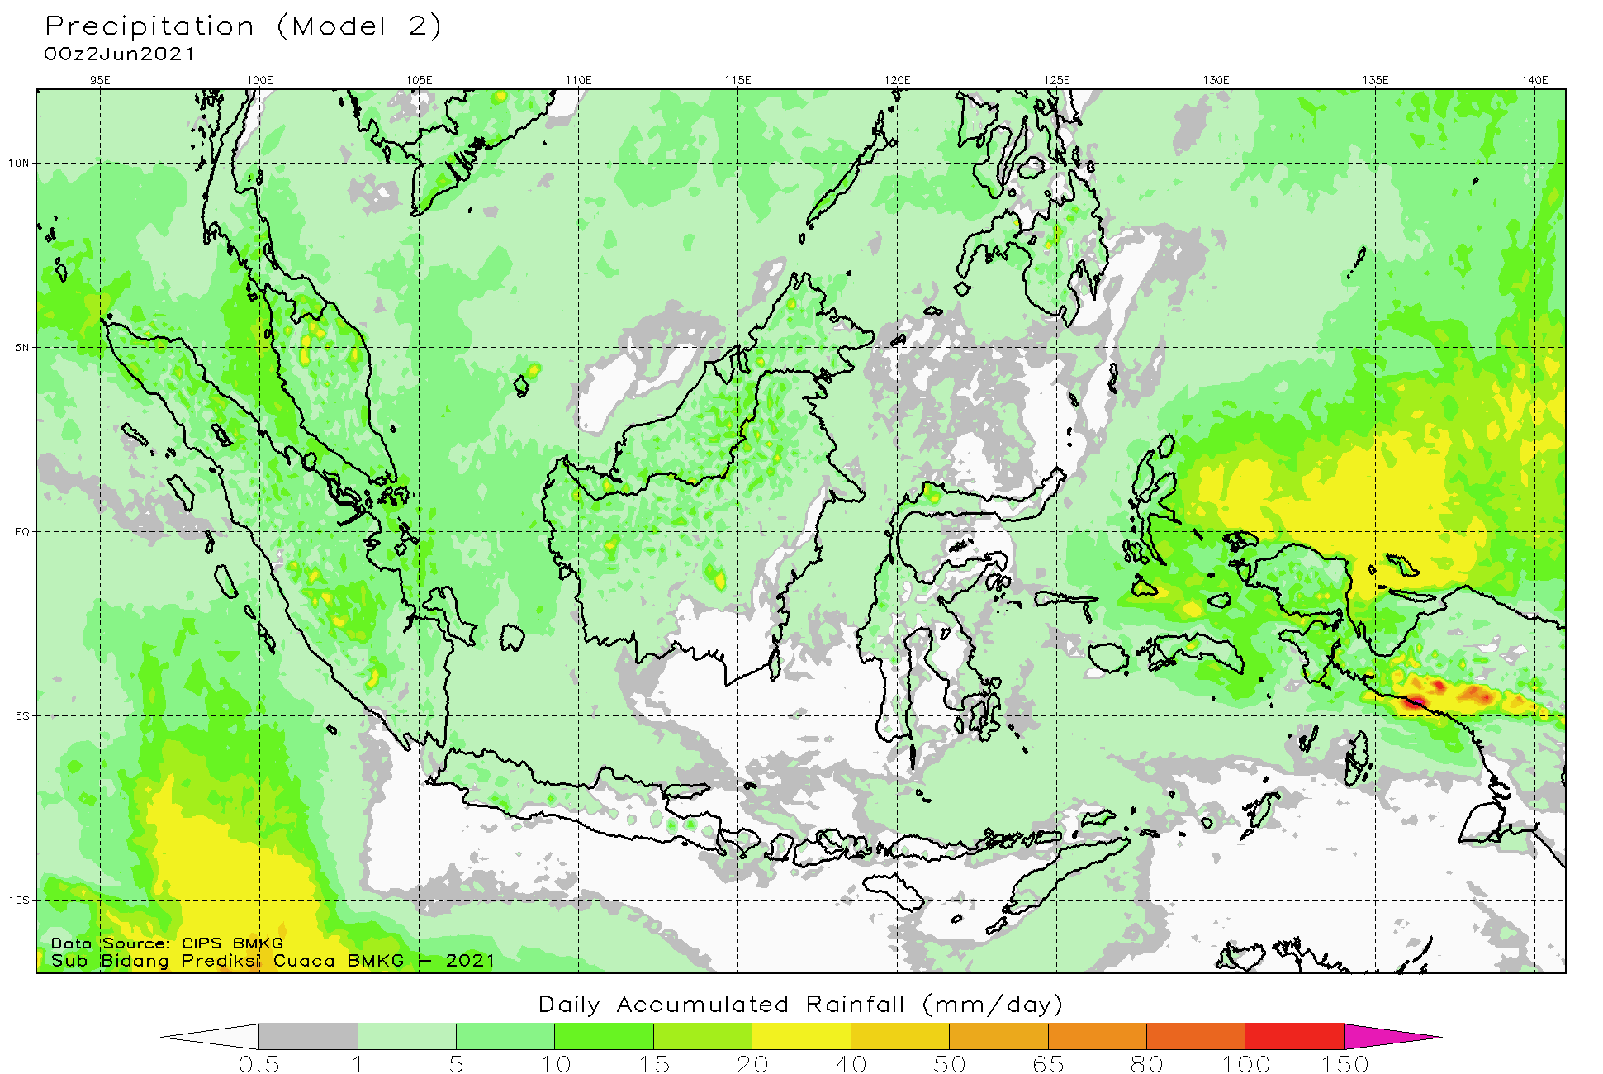
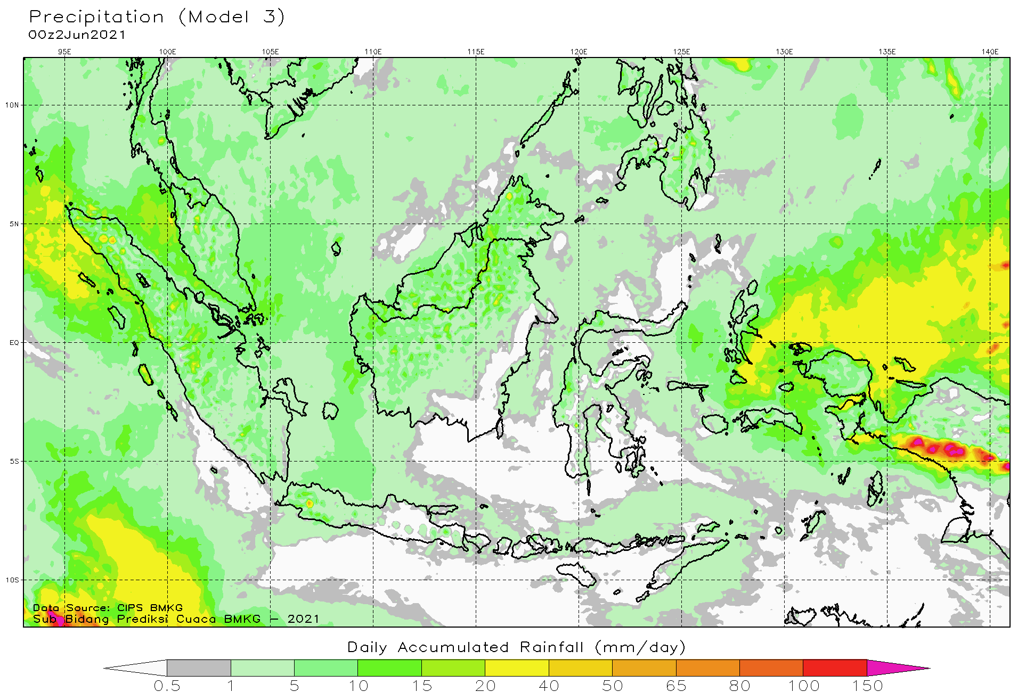
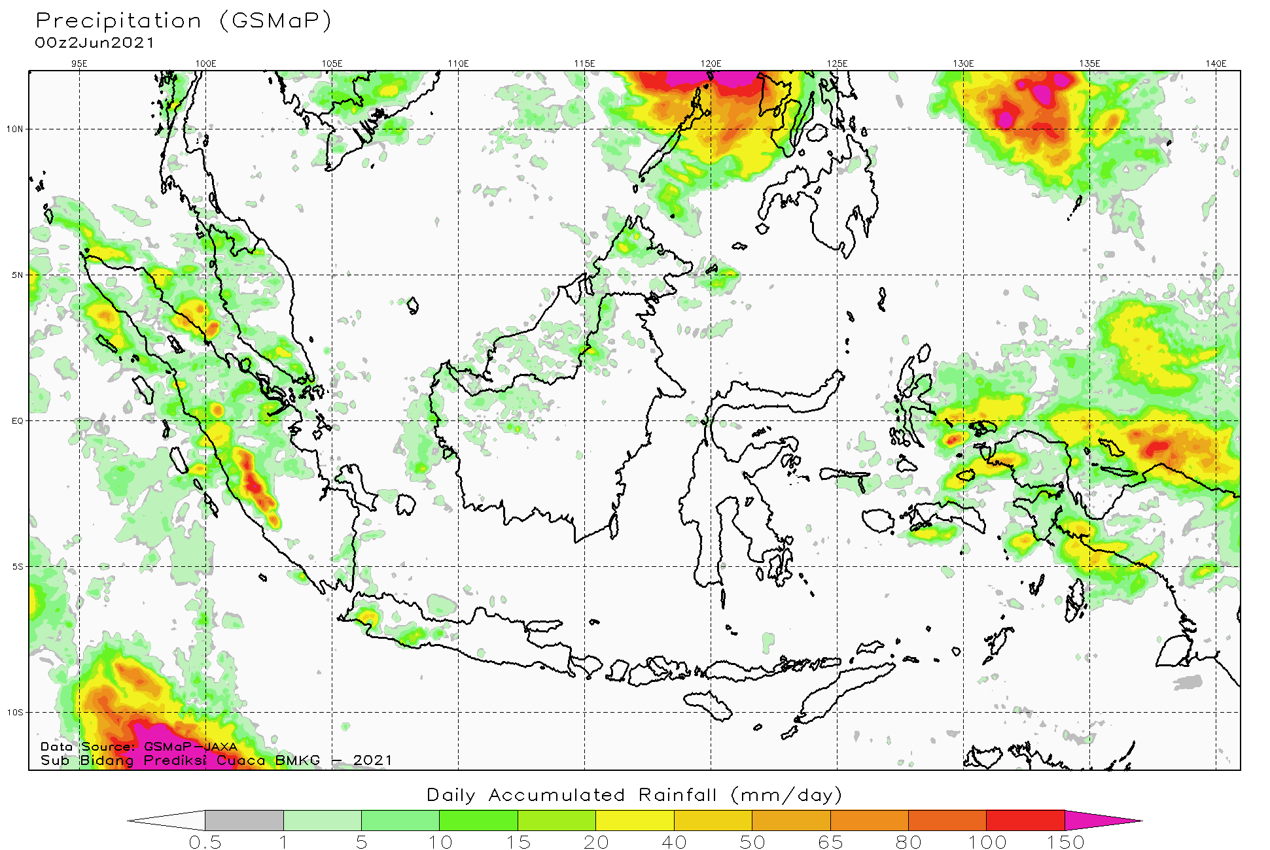
2 June 2021
Analysis
Model 1
Model 2
Make analisis referring to 3 keys of eyeball verification for spatial map:
1) Intensity
2) Location
3) Area Coverage
Model 3
GSMaP

Slide 6
THANK YOU
Give me some questions if you have some missing parts

